Slide 1
Cu-2021-110 Vitesse, LLC Height Limit exception
September 21st, 2021
Casey Kaiser
Senior Planner

Slide 2
Proposal
PROPOSAL
The applicant is requesting approval to build to a maximum height of 60 feet, exceeding the M1 zone height limit of 50 feet on a potential future building addition/expansion.
ZONING
The subject property is within the City, zoned M1 Light Industrial, and designated light industrial in the City’s Comprehensive Plan.
NOTICE
Neighbor Notice: Mailed out Aug 26th, 2021
Newspaper Notice: Published Sep 7th, 2021

Slide 3
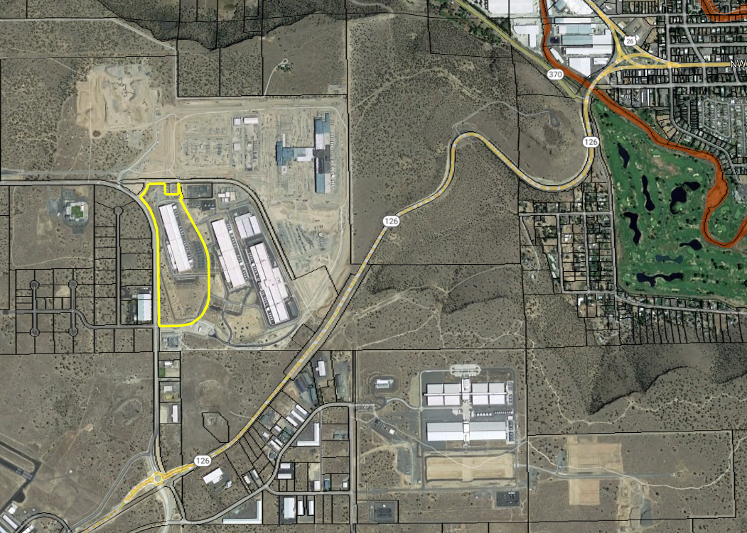
Location
511 SW Connect Way, Map & Tax Lot 15-16-0100 01102

Slide 4
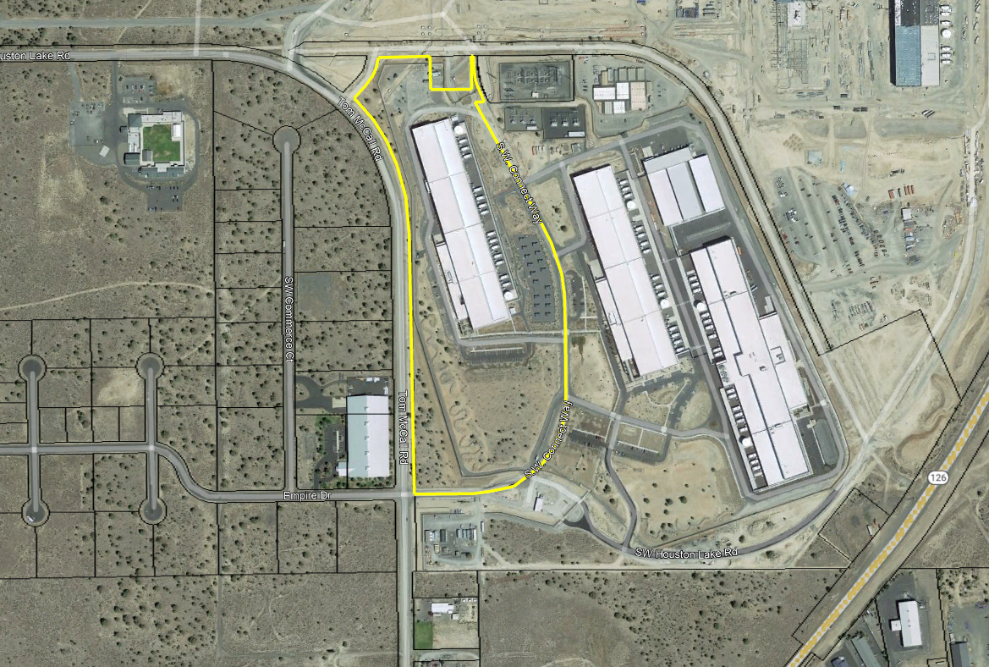
Site Description
The site contains a data center building PRN1 and associated site improvements including access roads, parking, and landscaped areas.

Slide 5
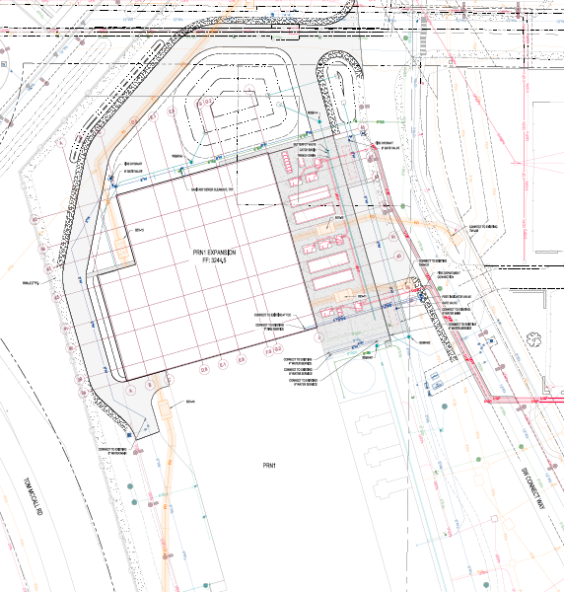
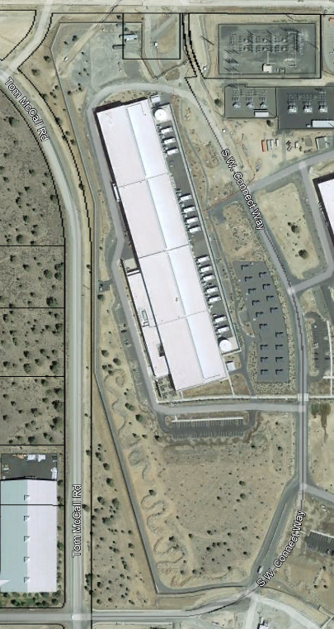
Potential Expansion – PRN 1

Slide 6
Potential Expansion – PRN 1

Slide 7
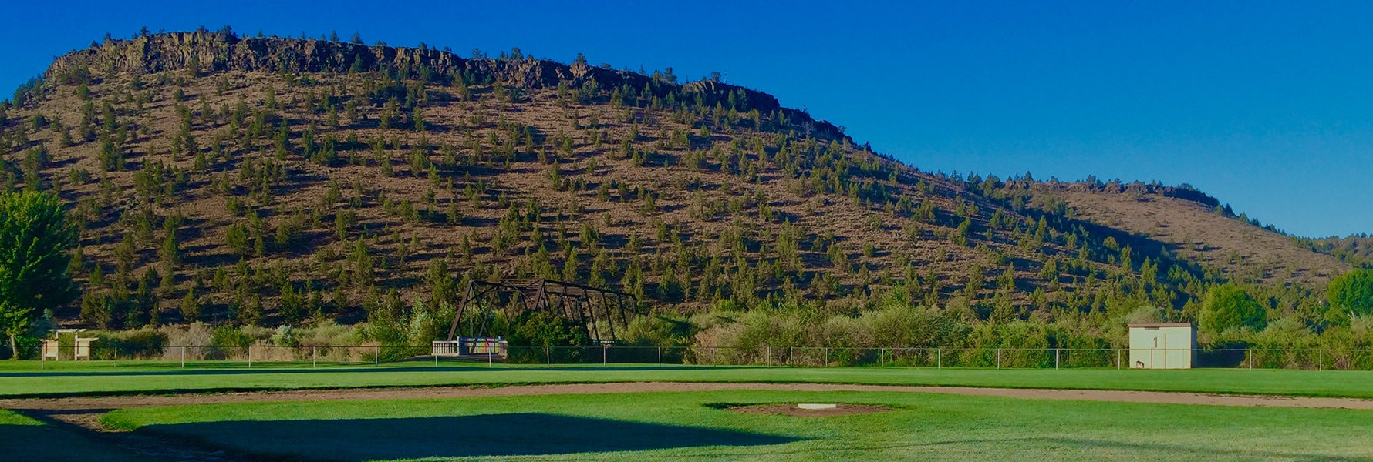
Findings Summary
The proposed request for an exception to the maximum height limit in the M1 Light Industrial Zone can be approved as a Type II Conditional Use.
The proposed increase to a maximum height of 60’ is not anticipated to adversely impact the surrounding industrial area or airport operations.
The proposed height increase will not adversely impact the scenic quality of the rimrock.
The proposal is being approved for the entire parcel. No portion of the property is within the 200’ rimrock setback.

Slide 8
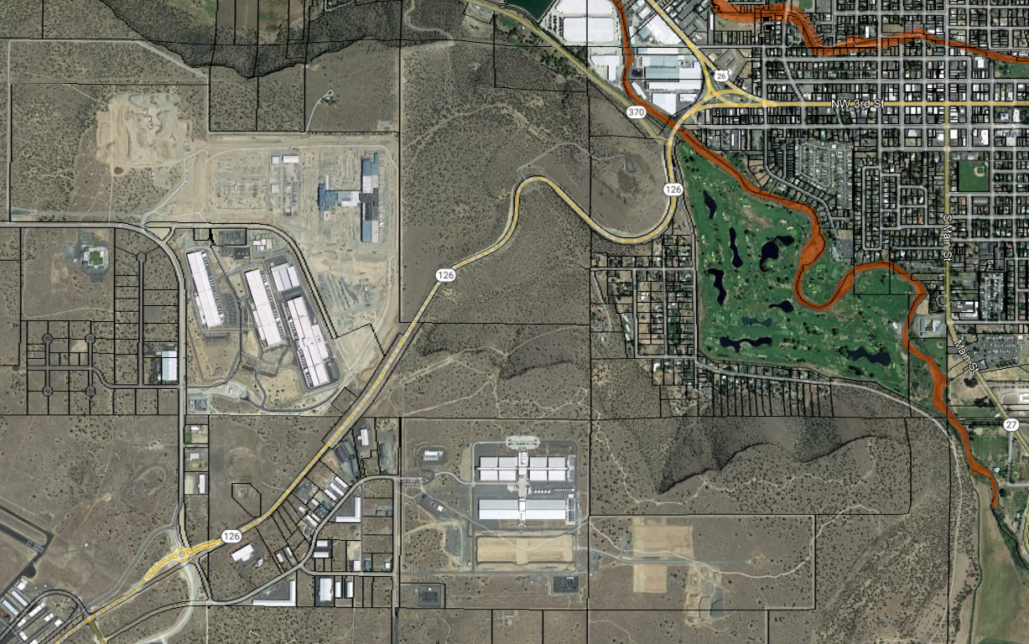
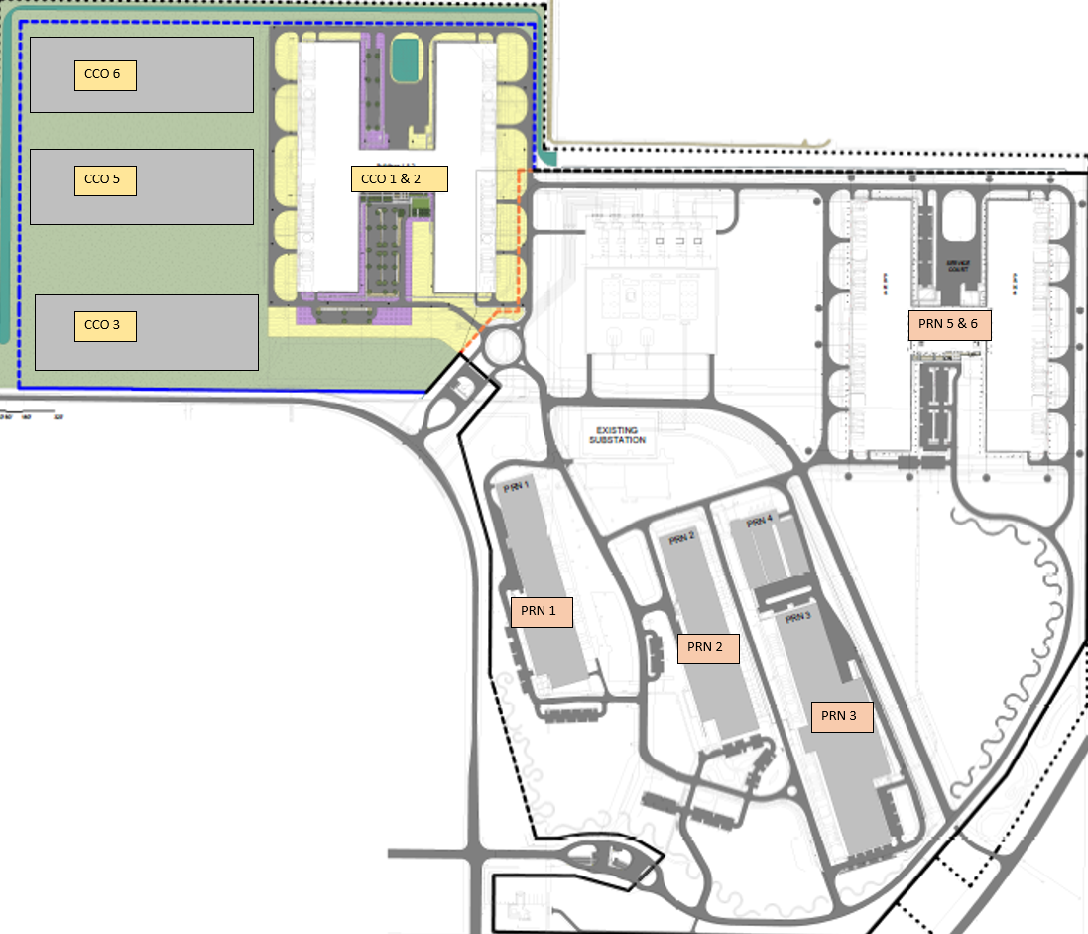
View Shed

Slide 9
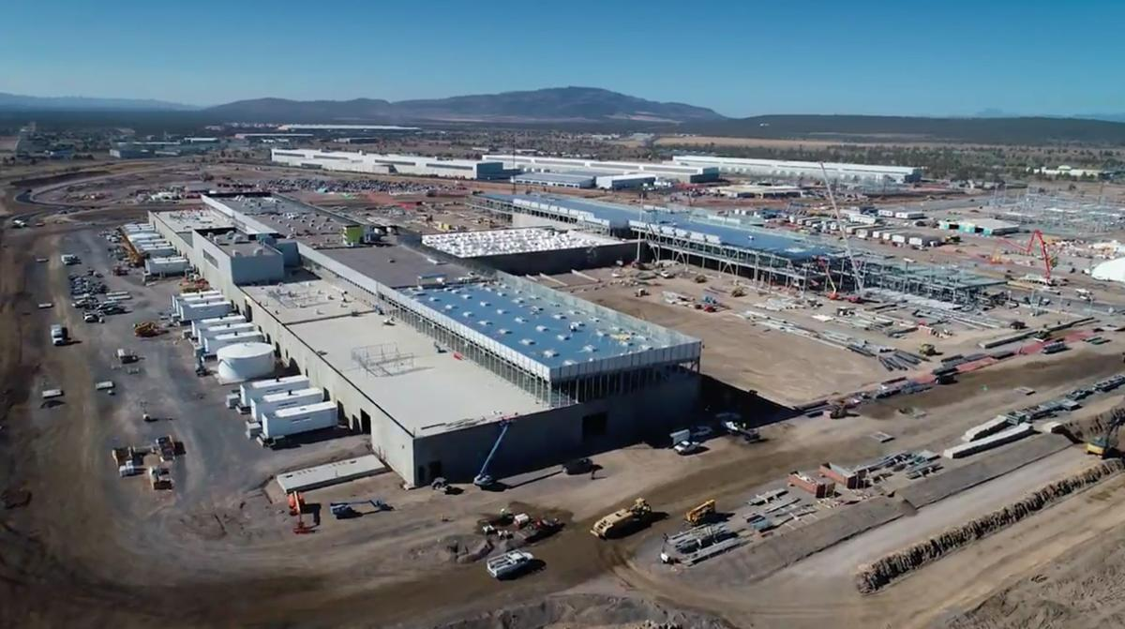
Public Comments
There were no public comments.
There were no comments from any public agencies.

Slide 10
Decision
MOTION IN FAVOR
The Staff Report and record of tonight’s proceedings are hereby incorporated as Findings of Fact in Favor of this Application. I move that the application be APPROVED, subject to the Conditions of Approval as they have been finalized, and based upon the Findings of Fact in favor of the application.
MOTION IN OPPOSITION
The Staff Report and record of tonight’s proceedings are hereby incorporated as Findings of Fact in Opposition to this Application. I Move that the request be DENIED based upon Findings of Fact in opposition to the application.

Slide 11
Questions?

