Slide 1
Planning Commission
December 15th, 2020

Slide 2
CU-2020-104
Single Family Home in C2 zone
The applicant is requesting permission to place a single family home with garage on a property bisected by a wetland and zoned General Commercial (C2). A more specific site plan will be approved by staff when the exact building design is known.

Slide 3
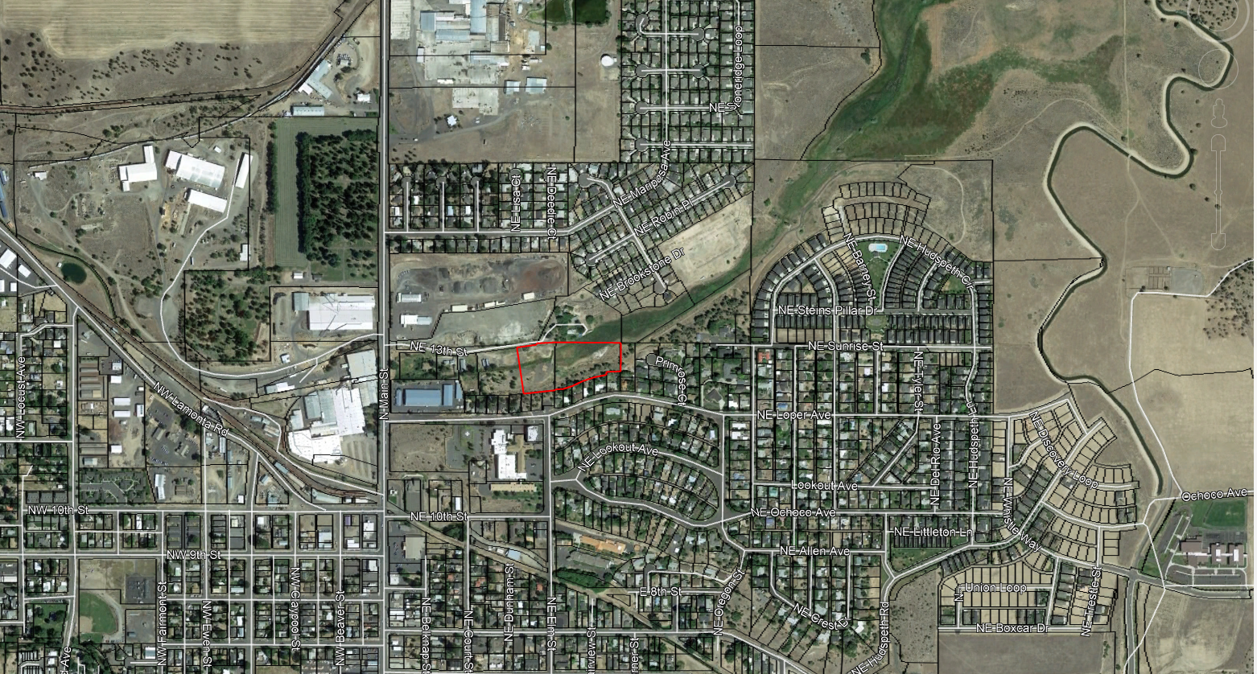
Overview: 4.69 Acre Parcel at bottom of Hudspeth Drain
The property was adjusted to its current configuration by application BA-2020-100

Slide 4
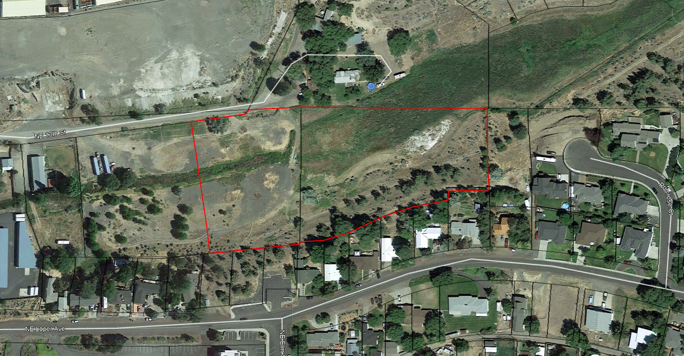
Property has been adjusted.
Previous application Cu-2018-108 approved a home with similar conditions on the remaining property to the west.

Slide 5
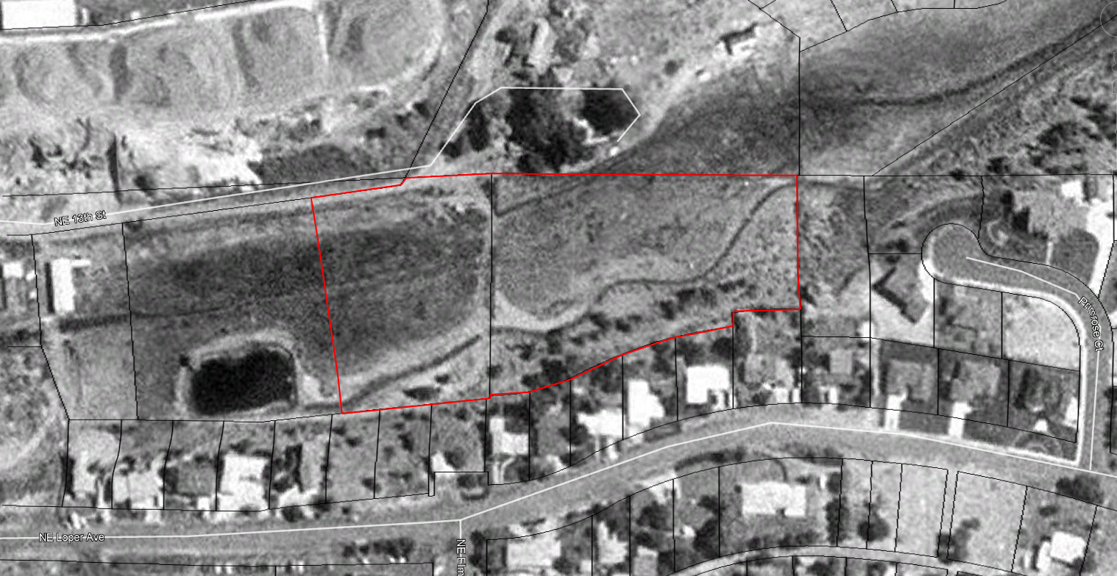
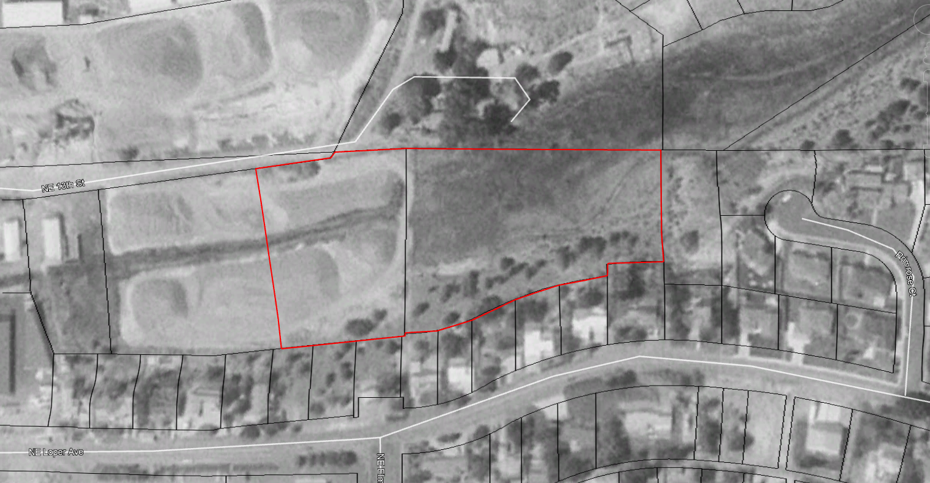
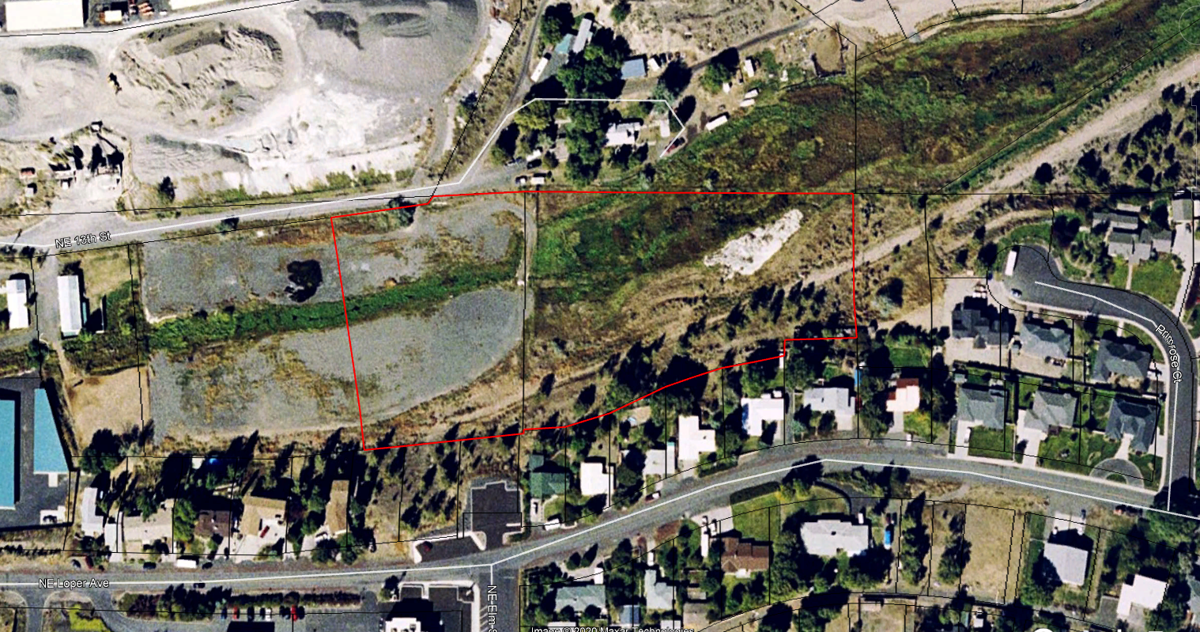
Aerial Views: (1994, 2000, 2006, 2018)

Slide 6
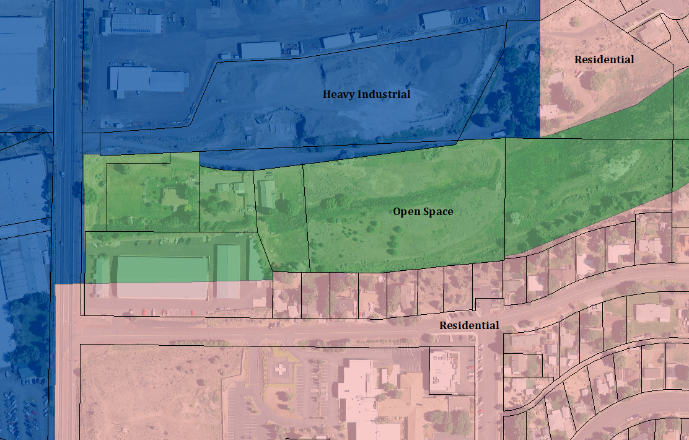
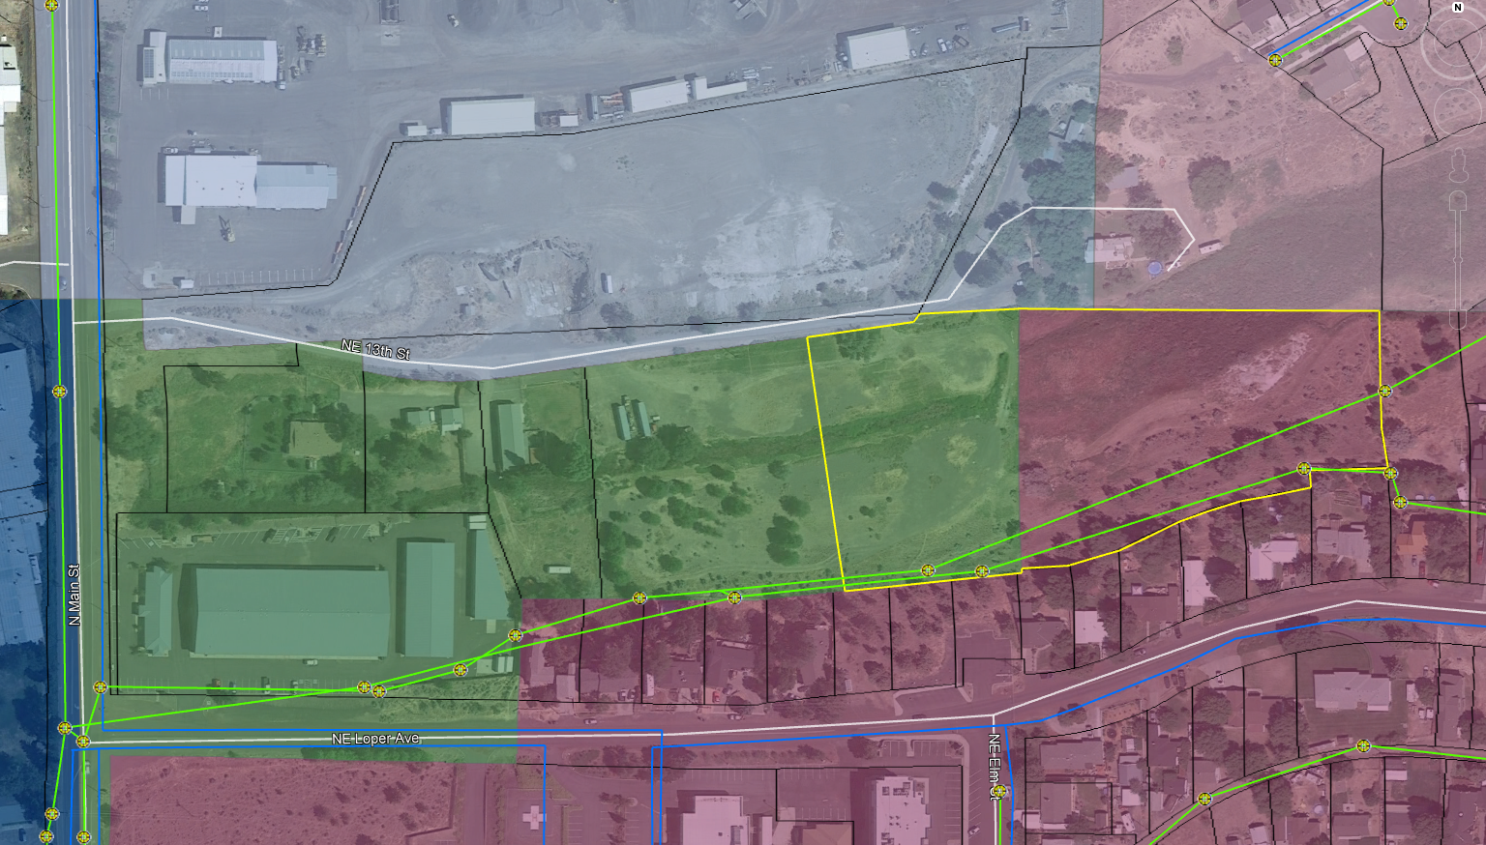
Zoning – C2 & R1
Comp. Plan Zoning
R2
M1
R1
M2
C2

Slide 7
Commercial viability
153.083 STANDARDS FOR SPECIFIC USES.
(T) Residential dwellings in a commercial zone. Residential uses from single family dwelling to fourplexes shall consider the following limitations when placed in a commercial zone.
(1) Structures shall not be located on a major collector or arterial streets unless;
(2) The property is determined not to be commercially viable based on size, location and surrounding uses.
(3) Provisions for the future conversion to a commercial business should be considered when placing a residence on a lot.
The proposed site is not located on a major collector or arterial street. The property is accessed from an easement, named 13th Street for addressing purposes.
Staff does not see the property as commercially viable due to the properties location off an unimproved access road, at the bottom of a drainage, adjacent to a wetland, with limited access to City services.
3) Staff does not believe this is applicable.

Slide 8
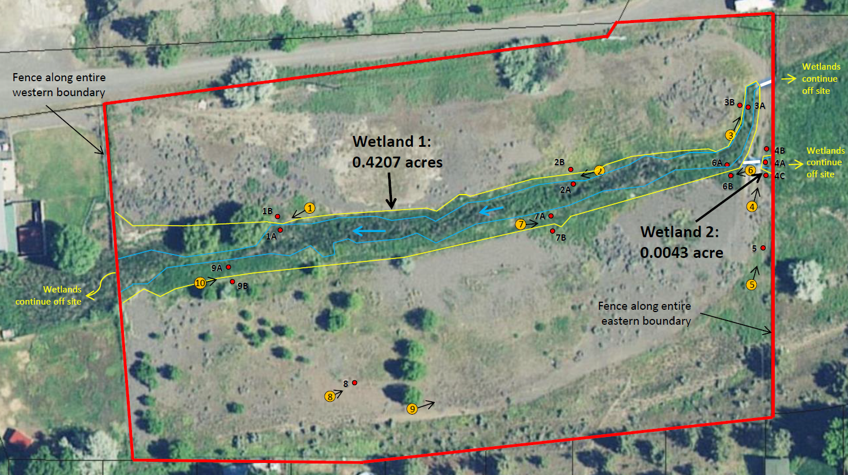
Wetland Delineation (Acknowledged by DSL)

Slide 9
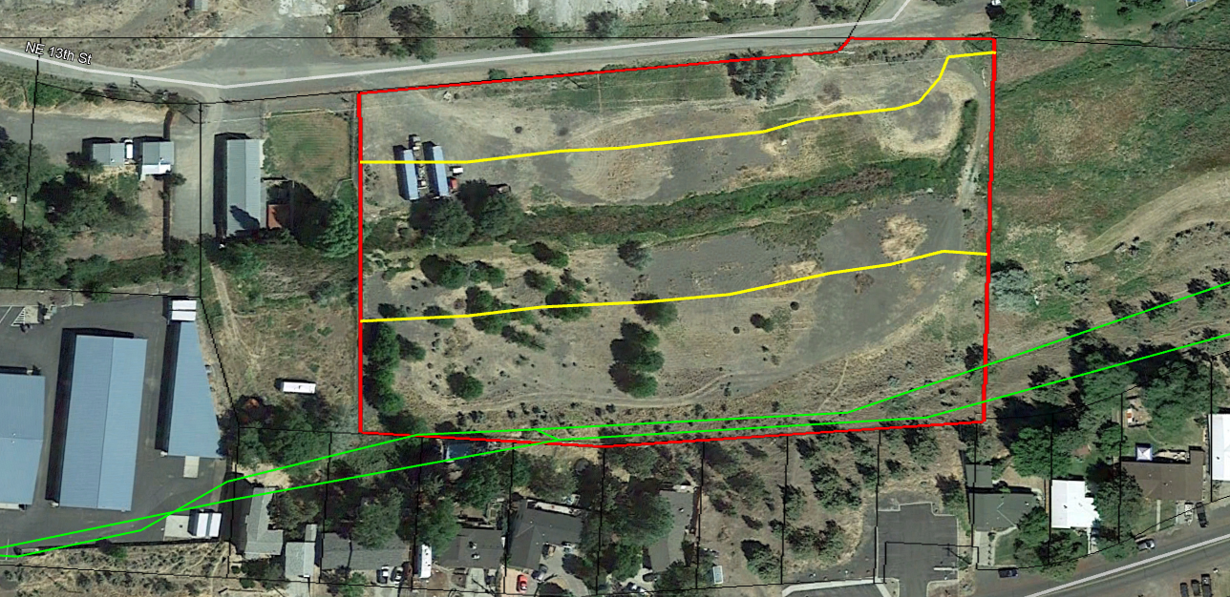
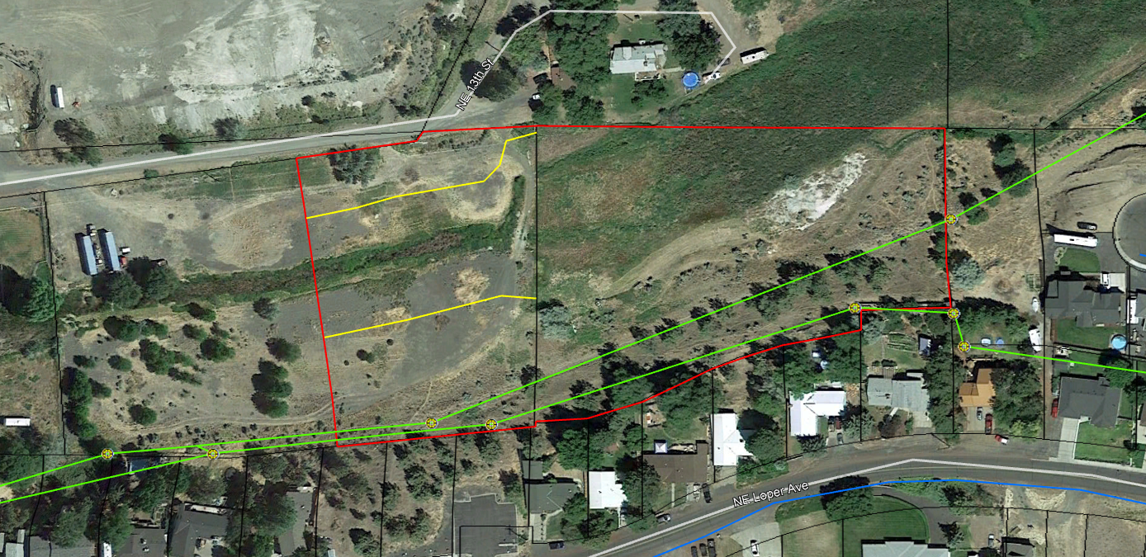
Approximate setbacks from Wetland.
Setbacks and wetland on the entire property shall be recorded as an open space, wetland and drainage easement to the City in accordance with section 153.192 of the City’s Land Use Code. This is similar to requirements east and west of this property. A portion of this property has not been delineated in order to determine setback line.
~60 at widest
Unknown Wetland boundary
~90’ at widest

Slide 10
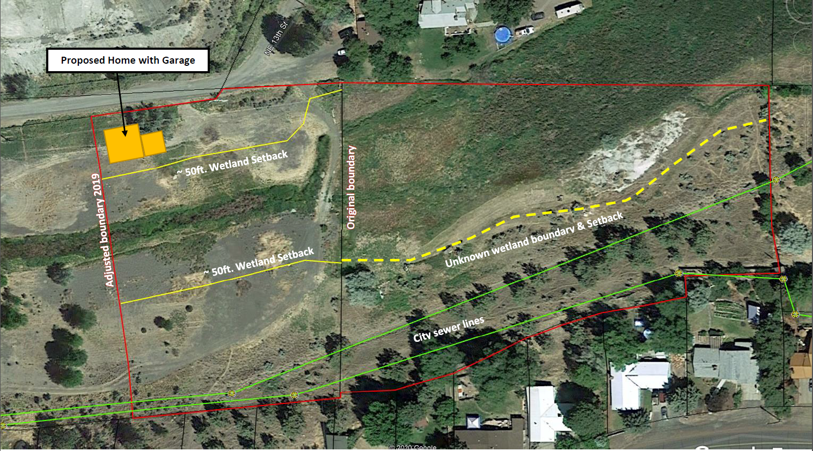
Approximate location
Final site plan may be altered prior to building permit based on final setback location.
Sewer connection may require DSL permit to cross wetland.
Water service and/or public water line including required fire hydrant within 600ft. will require easement over private property.

Slide 11
Discussion Points
Is the property Commercially viable?
Is a residential use appropriate?
Duration of this approval.
Approvals typically expire after one year.
If approved staff believes the residential use should not expire, however site plans approvals would.
Key conditions prior to Building permit.
Wetland boundary determination for remainder of property.
Legal description and signature for easement prepared by the City over wetland and setbacks.
P.UE. for access to City water for fire protection.

Slide 12
Questions?

